Slide 1
33rd International Colloquium of Gerpisa
The Central Role of China in the Global Automotive Industry
Theme No. 1: Challenges for Work and Labour
Twin Transition Strategies in the Automotive Industry: The Case of Toyota Motor de México in the Era of Electromobility and Chinese Leadership
Adriana Martínez Martínez – Jorge Carrillo
UNAM, ENES León – El Colegio de la Frontera Norte
24 June 2025
Session 6

Slide 2
Study Objectives
Analyze how the twin transition is implemented at TMMGT.
Understand tensions between digitalization and sustainability.
Explore the role of local capabilities versus global decisions.

Slide 3
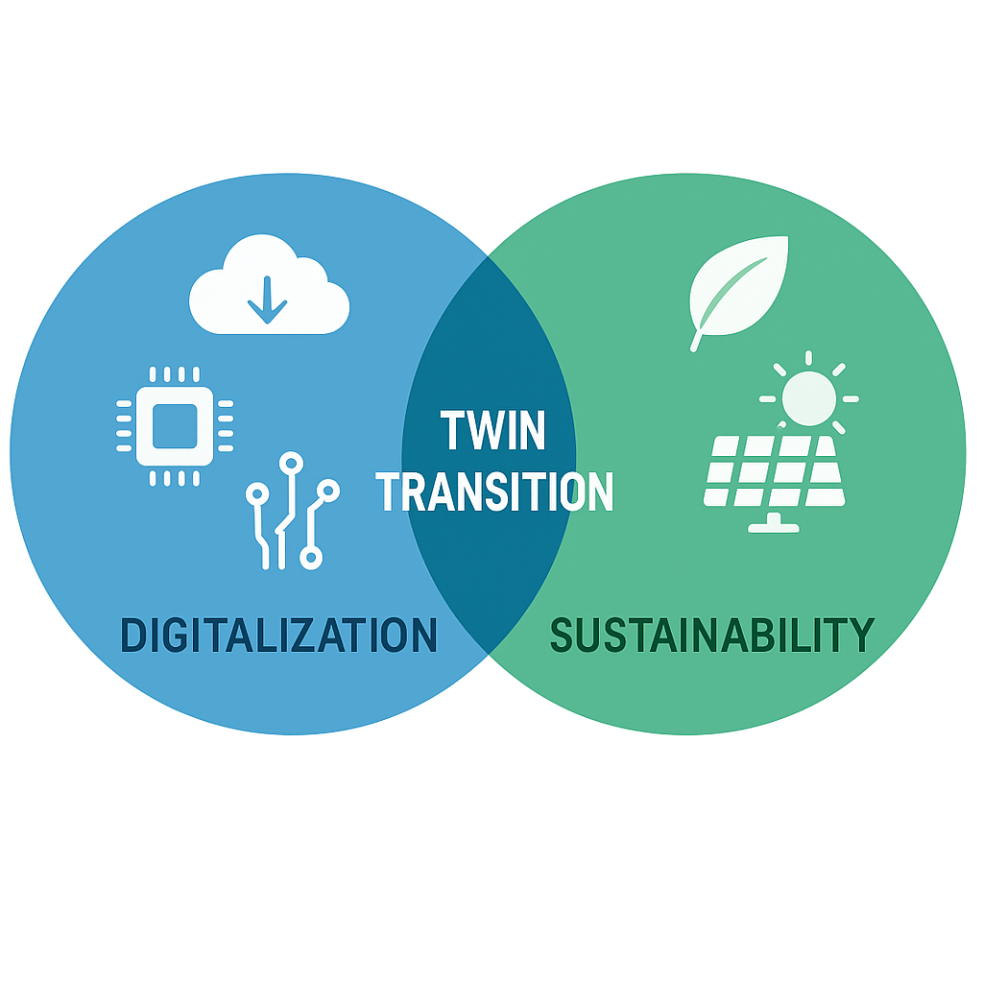
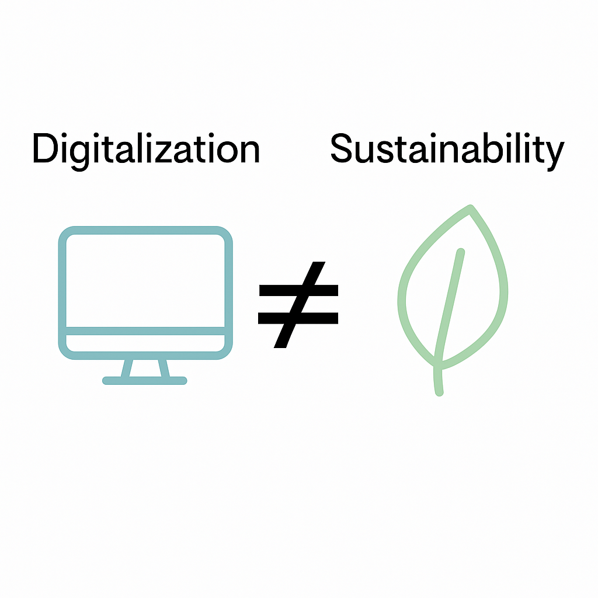
Conceptual Framework: Twin Transition
Convergence of digitalization and sustainability.
Promoted by EU industrial policy.
Involves organizational redesign and new job profiles.
The twin transition demands both technological and organizational redesign.
Tensions arise between incremental (gradual, low-risk improvements) and disruptive innovation (radical shifts that challenge existing models), shaping how firms navigate the twin transition.
Two-speed” transitions: digital and green changes often advance at different paces. Innovation

Slide 4
Global Models in Tension: Toyota vs BYD
 | TOYOTA | BYD
Strategy | Gradual | Disruptive
Priority technology | Multipath way strategy: Hybrids, plug-ins, BEVs, hydrogen | Full electrification
Type of integration | Selective integration | Vertical integration
Type of transformation | Selective digital transformation, aligned with the principles of TPS | Rapid expansion in emerging markets
These contrasting strategies show how legacy and emerging automakers approach the twin transition with different timelines, risks, and regional priorities.

Slide 5
Methodology
Qualitative case study approach.
23 interviews conducted between 2021 and 2025.
Thematic analysis (Braun & Clarke, 2006).
Key informants from various hierarchical levels and functional areas of TMMGT, including innovation, maintenance, engineering, human resources, technological development, and the presidency.

Slide 6


TMMGT Context
Located in Apaseo el Grande, Guanajuato, Mexico.
Sits on 620 hectares of land, 2400m2 of construction
Strategic location and infrastructure
Local integration and human capital
Started operations in 2019 (Tacoma production).
🚗 Initial investment of $700M USD. 📈 Production grew: 100,000 units in 2021- 138,000
in 2022- 123,000 in 2023- 138,000 in 2024.
Designed from scratch: energy efficiency and lean focus.
🌱. Recycles 80% of its water; 20% reused for irrigation. ⚙️ Built around the Toyota Production System (TPS):
Just-in-time, Kaizen, and Jidoka.
Peripheral subsidiary with limited strategic autonomy.
📋 Follows global TPS with local adaptations. Operates under a flat organizational structure
with 7 hierarchical levels;

Slide 7
Progressive Digitalization and Automation
Gradual adoption of automation in bodywork, stamping, and logistics.
Internal development and local collaboration (e.g., RFID drone system).
RFID drone system: reduced audit time in trailer yard from 4 hours to 30 minutes by enabling fast supply location.
Integration with lean principles enhances sustainability.
Solutions scaled to global Toyota database.
Stamping- 12 robots/ 5.6% employees
Press: latest technology generation
Body: 58 robots, 1 robot for training, 4 AGVs, and an automatic transporter
Welding: 50 % automated
Painting: highly automated, concentrate 16.9% of employees
Assembly and quality: mostly manual, 46.9% employees

Slide 8
AI and Emerging Technologies
Solutions developed in-house with university support.
TMMGT–UAQ collaboration (2021–2022): co-developed 5 Industry 4.0 projects through joint engineering teams, some examples:
COVID-19 challenges catalyzed internal innovation.
Feature | Problem Solved | Automation Solution
Weld Burr Detection | Burrs compromise quality and safety | 🔧 1 robot with vision system replaces manual inspection
Fault Trend Monitoring | Equipment failures = overtime & errors | 📊 Predictive software + sensors send alerts & solutions
Hard-to-Reach Areas | Manual checks difficult in confined zones | 🤖 AVS “rovers” (AGVs with AI) detect errors autonomously

Slide 9
Green Transition: Multipathway Strategy
Hybrid, plug-in hybrid, BEV, and hydrogen vehicles.
Toyota follows a gradual, flexible path, developing multiple vehicle types in parallel rather than prioritizing full electrification.
Strategy adapted to infrastructure and energy contexts.
Hybrids support decarbonization without depending on charging infrastructure—crucial in contexts like Mexico.
Hybrid Tacoma symbolizes this localized approach.
Toyota chose hybrids as a realistic short- and mid-term solution due to limited EV charging infrastructure.
Emphasis on real emissions reductions and pragmatic adaptation.
For Toyota, decarbonization means more than just switching drivetrains—it requires clean energy. Otherwise, EVs simply shift pollution from tailpipes to power plants.

Slide 10
Training and Organizational Culture
All staff trained in production and TPS philosophy.
Dojo training for cultural immersion and continuous improvement.
All new hires undergo mandatory dojo training—learning production skills, risk detection, teamwork, and continuous improvement from day one.
Emphasis on “Mendomi”: people-centered leadership.
“Seeing with the eyes of the heart”: a people-centered leadership model at TMMGT, fostering empathy and team care among mid-level managers.
Cultural change from top-down to collaborative practices.

Slide 11
Supplier Relations and Knowledge Co-creation
Long-term partnerships with academia and local suppliers .
Collaborates with the UAQ to develop talent with digital skills through a postgraduate program in AI
TMMGT has 16 global suppliers,11 operate (in situs) at the Toyota Industrial Campus.
Projects co-developed, not just outsourced (e.g., RFID drones).
The RFID drone project was co-developed by TMMGT, a Mexico City tech firm, and a hardware company from Aguascalientes.
Knowledge sharing via Toyota’s internal database.
Example of distributed innovation and regional ecosystem building.

Slide 12
Gender and Diversity in Technical Roles
Increasing presence of women in engineering and innovation.
In just 3 years, the share of women in production roles rose from 20% to 27%.
In pilot design, female engineers lead with full technical authority—highlighting their presence and leadership in roles traditionally overlooked (Interview, September 1, 2022).
Institutional efforts toward gender equity.
TMMGT is moving beyond a male-dominated structure—diversity is seen not as a quota, but as a driver of innovation and leadership (Interview, September 2022).
Women lead critical projects
Women have played a direct and decisive role in technological initiatives such as the machine vision burr detection system.
Inclusion linked to innovation, leadership diversity, and equity.
Toyota Mexico's experience shows that the twin transition is not gender-neutral, and that its effective implementation requires cultural and structural change—gender inclusion is not a byproduct, but a key driver of success.

Slide 13

Discussion: Limits and Learnings
TMMGT innovates, but strategic decisions made externally.
Toyota’s gradualism faces BYD’s disruptive pace, reflecting different risk profiles and institutional contexts.
Twin transition is contested, not linear.
Collaboration (e.g., with BYD) highlights hybrid global strategies where legacy and newcomer firms navigate overlapping transitions.

Slide 14
Conclusions
The twin transition is fragmented and uneven in peripheral contexts, where local realities often clash with global frameworks.
TMMGT exemplifies a context-sensitive, incremental approach, driven by local learning and adaptation aligned with Toyota Production System (TPS) principles.
These innovations are embedded in a broader organizational transformation, requiring not only technical changes but also cultural and structural shifts.
Strategic constraints—such as centralized decision-making—limit the plant’s autonomy and global recognition, despite its innovative contributions.
Collaboration with universities and local suppliers has enhanced adaptability and promoted distributed innovation across the regional ecosystem.
Importantly, the case shows that gender inclusion and leadership diversity are not peripheral goals, but fundamental enablers of sustainable innovation.
Moving forward, supportive public policies and institutional frameworks are essential to expand local capabilities and ensure a just, inclusive, and territorially grounded twin transition.

Slide 15
Acknowledgements and References
Supported by ILO-European Commission & UNAM
Carrillo, Martinez, Lopez & Diaz, The automotive sector in Mexico: The impact of automation and digitalization on employment, Research Paper no. 15, ILO-European Commission, Geneve, April 2023.
Martinez, A. Impact of electromobility on the auto parts sector: opportunities and challenges. DGAPA PAPIIT Project IN305525

